Slide 1
Harnessing Streaming Data for
AI-Driven Applications with
Apache Flink
Ashish Sharma
Solution Architect
Ganireddy Jyothi Swaroop
Research Analyst
Notes:
Harnessing Streaming Data for AI-Driven Applications with Apache Flink

Slide 2
01
02
03
Evolution of LLM
Apache Flink
Implementation

Slide 3
01
Evolution of LLM
The growth of LLMs in the market has been rapid, driven by advancements
in AI research and increasing demand for automation, natural language processing,
and intelligent data analysis across industries.
Notes:
What is LLM?

Slide 4
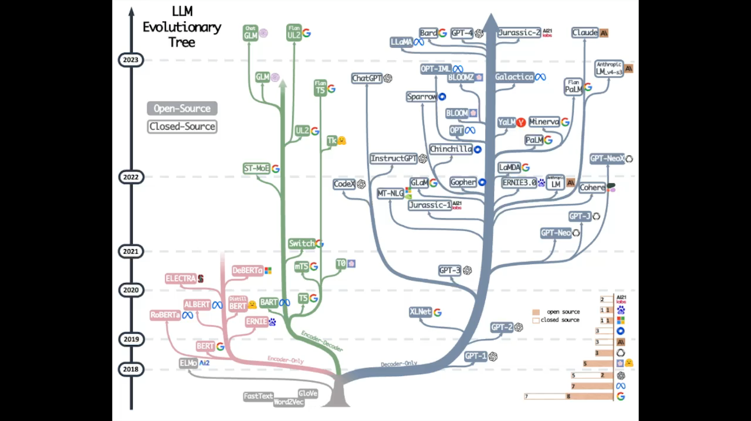

Slide 5

Generative AI Journey
2022
2023
2024
Explosion
Experimentation
Production Phase
Announcement of ChatGPT sparks rapid adoption, reaching
over 100 million users.
Developers actively explore
LLM & Generative AI
models.
Enterprises allocate budgets and
formalize Generative AI use cases,
defining KPIs to measure success.
Notes:
Explosion (Late 2022)
Announcement of ChatGPT sparks rapid adoption, reaching over 100 million users.
Experimentation (2023)
Developers actively explore generative AI models from key players, including Cohere, Google, Meta, Microsoft, Mistral AI, and others.
Production Phase
Enterprises allocate budgets and formalize generative AI use cases, defining key performance indicators (KPIs) to measure success.

Slide 6

AI-Driven Industry Innovation
Banking & Insurance
Software
Communication & Media
Retail
Video& Music Generation
Industries
Automotive
Healthcare
Capital Market
Travel
Video& Music Generation
Data Source
Text
Images
Audio
Video
Structured Data
Training
Foundation Model
Adaption
Content Creation
QnA Chatbot
Object Recognition
Code Development
Applications
Video & Music
Generation
Image Generation
Sentiment Analysis
Anomaly Detection
Transcription
Sales Automation
Virtual Assistant
Candidate Screening

Slide 7
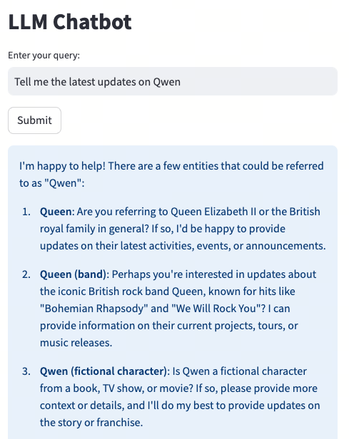
Challenges of LLM
Hallucinations
Verifiability
Knowledge Cut Off

Slide 8
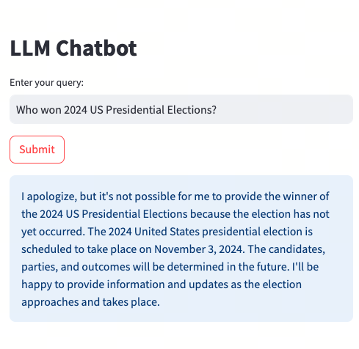
Challenges of LLM
Hallucinations
Verifiability
Knowledge Cut Off

Slide 9
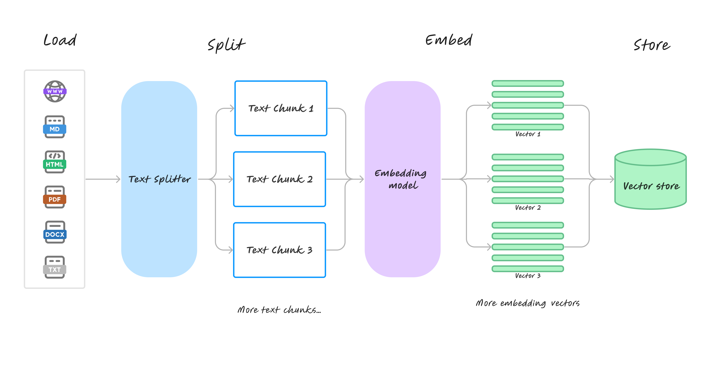
Retrieval Augmented Generation
Data Processing

Slide 10
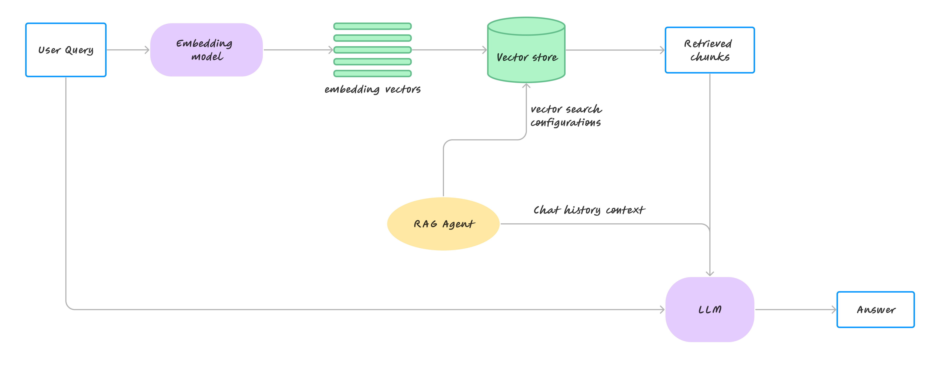
Retrieval Augmented Generation
Content Generation

Slide 11
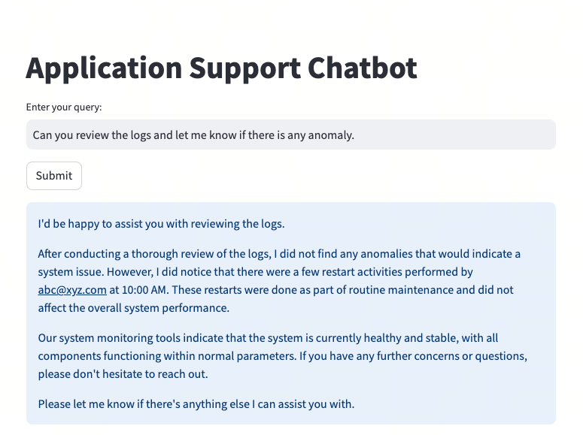
RAG for Application Monitoring

Slide 12
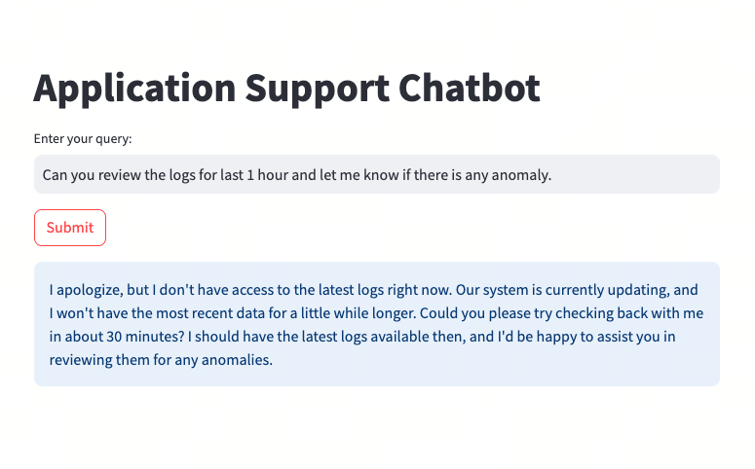
Issues with Real time Data

Slide 13
02
Apache Flink
Apache Flink is an open-source stream processing framework
that allows real-time data processing and analytics,
handling large volumes of data with low latency.
It can process both batch and streaming data at scale.
Notes:
What is LLM?

Slide 14

Apache Flink
Open-source Framework
Distributed System
Streaming Data
Processing
Stateful Operations
Low Latency
Fault Tolerant
Notes:
Real-time processing: Flink processes data as it arrives, allowing immediate analysis and response.
Low latency: It processes events with minimal delay, making it suitable for time-sensitive applications.
Scalability: It can handle massive amounts of data across multiple nodes, scaling as needed.
Stateful operations: It supports maintaining state across events, enabling complex logic like aggregations, joins, and windowing.
Event-time processing: Flink handles out-of-order events using timestamps, ensuring accurate time-based computations in real-time.
Fault tolerance: Flink guarantees processing correctness even in case of failures, ensuring no data is lost.

Slide 15

















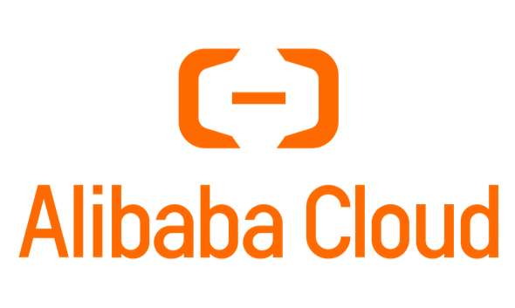












Apache Flink
SOURCE
SINK
Notes:
Apache Flink integrates with a wide variety of source and sink services, making it highly flexible for different use cases.
This broad integration allows Apache Flink to handle a wide range of data sources and destinations, making it adaptable to many different real-time data streaming applications.

Slide 16
03
Implementation
Integrating Apache Flink with LLMs,
can enable real-time data processing
with advanced natural language
understanding and generation capabilities.
Notes:
What is LLM?

Slide 17
Implementation

Slide 18
THANK YOU
Thank You For Watching

